Slide 1
Tobacco Questions for Surveys (TQS):
A Subset of Key Questions from the Global Adult Tobacco Survey (GATS)
Orientation Workshop on TQS
3-4 May 2016
Ankara, Turkey

Slide 2
Overview
Introduction to TQS
TQS Guide Booklet
Implementation Guidelines
Examples of TQS Implementation
Partnerships & Global Alliance
Questions/Discussion

Slide 3
Introduction

Slide 4
Background
WHO FCTC / MPOWER: Efficient and systematic surveillance mechanism
Standard set of tobacco questions across various surveillance activities
Consistency and comparability in monitoring tobacco use
GATS developed to generate comparable data within and across countries

Slide 5
Global Standards
Various surveys measure tobacco use in different ways
  Sample design
  Methodology: e.g., mode of administration
  Questionnaire
GATS questions have become “Global” standard for systematic monitoring of tobacco use and key tobacco control indicators

Slide 6
Development of TQS
2008: Request to select key questions from GATS to propose for ongoing surveys
2009-2010: Development of easy to use guide
2010: TQS 1st Edition launched in Dublin, Ireland
2011: TQS 2nd Edition
2013: TQS translations available in 7 languages
2013: Global Launch - Geneva, Switzerland

Slide 7
TQS Features
Simple, standard, scientific & tested questions
Include questions into national and international surveys
  National health surveys, multi-risk factor surveys, demographic health surveys, non-health surveys
Sustainable monitoring of tobacco use & key policy measures
Enhancement of capacity for global monitoring, comparability, pool of reliable data

Slide 8
TQS Guide Booklet

Slide 9
Structure of TQS Guide
Menu of tobacco indicators/survey questions:
  Questions on smoking prevalence (3 questions)
  Questions covering key MPOWER topics (19 questions)
Select indicators and corresponding survey questions based on need and tobacco control situations
Select all or some of questions

Slide 10
TQS Content – Key Prevalence Questions
 | Tobacco Topic | Indicator Name and Description
Monitor | Q1. Current tobacco smoking status Q2a. Past daily smoking status (for current less than daily smokers) Q2b. Past smoking status (for current non-smokers) | Current Tobacco Smokers Percentage of respondents who currently smoke tobacco. Current Daily Tobacco Smokers Percentage of respondents who currently smoke tobacco daily. Former Daily Tobacco Smokers (Among All Adults) Percentage of respondents who are ever daily tobacco smokers and currently do not smoke tobacco. Former Daily Tobacco Smokers (Among Ever Daily Smokers) Percentage of ever daily tobacco smokers who currently do not smoke tobacco.

Slide 11
TQS Content – Monitor
 | Tobacco Topic | Indicator Name and Description
Monitor | Q3. Number of tobacco products smoked per day | Current [Product] Smokers Percentage of respondents who currently smoke [product]. Cigarettes Smoked per Day Average number of cigarettes smoked per day (of daily cigarette smokers)

Slide 12
TQS Content – Monitor
 | Tobacco Topic | Indicator Name and Description
Monitor | Q4. Current smokeless tobacco use Q5a. Past daily smokeless use (for current less than daily users) Q5b. Past smokeless use (for current non-smokeless users) | Current Smokeless Tobacco Users Percentage of respondents who currently use smokeless tobacco. Current Daily Smokeless Tobacco Users Percentage of respondents who currently use smokeless tobacco daily. Former Daily Smokeless Tobacco Users (Among All Adults) Percentage of respondents who are ever daily smokeless tobacco users and currently do not use smokeless tobacco. Former Daily Smokeless Tobacco Users (Among Ever Daily Users) Percentage of ever daily smokeless tobacco users who currently do not use smokeless tobacco.

Slide 13
TQS Content – Protect
 | Tobacco Topic | Indicator Name and Description
Protect | Q6. Frequency of anyone smoking at home | Exposure to Secondhand Smoke at Home Percentage of respondents who report that smoking occurs inside their home.
 | Q7. Currently work outside home Q8. Work indoor/ outdoor Q9. Anyone smoke at work during the past 30 days | Exposure to Secondhand Smoke at Work Percentage of indoor workers who were exposed to tobacco smoke at work in the past 30 days.

Slide 14
TQS Content – Offer
 | Tobacco Topic | Indicator Name and Description
Offer | Q10. Tried to quit in past 12 months | Smoking Quit Attempt in the Past 12 Months Percentage of current tobacco smokers who tried to quit during the past 12 months.
 | Q11. Visiting a doctor in past 12 months Q12. Receiving advice to quit smoking from doctor | Health Care Provider’s Advice to Quit Smoking Tobacco Percentage of current tobacco smokers who visited a doctor or health care provider during the past 12 months and were advised to quit smoking tobacco.

Slide 15
TQS Content – Warn
 | Tobacco Topic | Indicator Name and Description
Warn | Q13. Noticing anti-cigarette information in newspapers or magazines | Awareness of Anti-Cigarette Information in Newspapers/Magazines Percentage of respondents who have noticed information about the dangers of smoking cigarettes or that encourages quitting in newspapers or magazines in the last 30 days.
 | Q14. Noticing anti-cigarette information on television | Awareness of Anti-Cigarette Information on Television Percentage of respondents who have noticed information about the dangers of smoking cigarettes or that encourages quitting on television in the last 30 days.
 | Q15. Noticing health warnings on cigarette packs | Noticing Health Warning Labels on Cigarette Packages Percentage of current smokers who noticed health warnings on cigarette packages in the last 30 days.
 | Q16. Thinking about quitting because of health warnings | Thinking of Quitting Because of Health Warning Labels on Cigarette Packages Percentage of current smokers who reported thinking about quitting smoking in the last 30 days because of the warning labels on cigarette packages.

Slide 16
TQS Content – Enforce
 | Tobacco Topic | Indicator Name and Description
Enforce | Q17. Noticing cigarette advertisements in stores | Awareness of Cigarette Advertising in Stores Percentage of respondents who have noticed any advertisements or signs promoting cigarettes in stores where cigarettes are sold in the last 30 days.
 | Q18. Noticing cigarette promotions | Awareness of Specific Types of Cigarette Promotions Percentage of respondents who noticed [free samples of cigarettes, cigarettes at sales prices, coupons for cigarettes, free gifts or discounts on other products when buying cigarettes, clothing or other items with a cigarette brand name or logo, cigarette promotions in the mail] in the last 30 days.

Slide 17
TQS Content – Raise
 | Tobacco Topic | Indicator Name and Description
Raise | Q19. Last cigarette purchase – quantity Q20. Last cigarette purchase – cost | Cost of Manufactured Cigarettes Average amount spent on a pack of manufactured cigarettes (in local currency). Cigarette Affordability Average cost of 100 packs of manufactured cigarettes as a percentage of Gross Domestic Product (GDP) per capita.

Slide 18
TQS Example: Survey Question
Q1. Current Tobacco Smoking Status
Do you currently smoke tobacco on a daily basis, less than daily, or not at all? DAILY 1 LESS THAN DAILY 2 NOT AT ALL 3 DON’T KNOW 7
Purpose Determines the current tobacco smoking status of the respondent. Instructions Ask question and record only one answer. (DON’T KNOW should not be read to the respondent.) Definitions Daily means smoking at least one tobacco product every day or nearly every day. Indicator 1 Current Tobacco Smokers: Percentage of respondents who currently smoke tobacco. Numerator: Number of current daily and less than daily tobacco smokers. Denominator: Total number of respondents surveyed. Indicator 2 Current Daily Tobacco Smokers: Percentage of respondents who currently smoke tobacco daily. Numerator: Number of current daily tobacco smokers. Denominator: Total number of respondents surveyed.

Slide 19
TQS Example: Analysis Table Shell
  Table 11-1. Detailed Smoking Status by Gender
Smoking Status | Overall | Male | Female
 | Percentage (95% CI)
Current tobacco smoker
Daily smoker
Occasional smoker
Occasional, formerly daily
Occasional, never daily
Current non-smoker
Former smoker
Former daily smoker
Former occasional smoker
Never smoker

Slide 20
Implementation
Guidelines

Slide 21
TQS Technical Package
TQS guide booklet
  English, Arabic, Chinese, French, Portuguese, Russian, Spanish
Mini fold-out pocket guide
  English, Arabic, Chinese, French, Russian, Spanish
Partner Guidance
TQS Fact Sheet

Slide 22
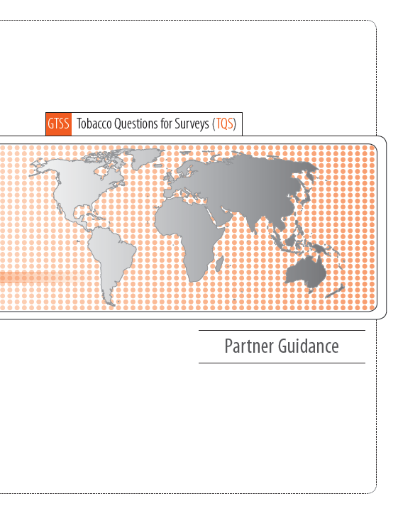
Partner Guidance
Recommended guidance for the integration of TQS into ongoing surveys
Describes technical assistance available from GTSS partners

Slide 23
Guidelines: Study Design
TQS questions developed for and tested in survey populations 15 years of age or older
  Development of “Youth TQS” underway
TQS questions developed for a face-to-face household survey
  Adaptation may be needed for other modes of administration (e.g., telephone, mail, internet)

Slide 24
Guidelines: Questionnaire
Encouraged to use all 22 TQS questions for comprehensive
TQS questions should be placed together
Placement in a multi-topic survey depends on survey purpose, topics, and length
Keep question wording the same for purposes of comparability and validity
  Minor adaptations may be needed

Slide 25
Guidelines: Use of TQS Data
Evaluation and monitoring of existing tobacco control policies and programs
Inform development and implementation of new interventions at community, sub-national and national levels
Comparison to past and current surveys with tobacco questions
  Interpret carefully, taking into account differences in survey methods (such as questionnaire wording, context, sample design, target population, mode of administration, etc.)

Slide 26
Guidelines: Technical Assistance
TQS is an open-source tool
  CDC tracks the use of TQS
Expert consultation from WHO, CDC
  Questionnaire: wording, skip logic, placement
  Study design: sample design, data collection procedures
  Analysis and reporting: construction of indicators, tables, graphs
Funding opportunities through CDC Foundation

Slide 27
Examples of Implementation

Slide 28
Survey Platforms for TQS Integration
National
Health surveys
TB surveys
Nutrition and examination surveys
Household living standards
International
STEPS
DHS
MICS
EHIS
Drug use surveys (UNODC/OAS)
RHS

Slide 29
TQS Implementation 2008-2016
Planned
In Progress
Completed
64 countries completed surveys with TQS integration

Slide 30
Implementation: Examples of GATS Countries
Argentina: National Risk Factor Survey, 2013
Bangladesh: WHO STEPS, 2010
Brazil: National Health Survey (PNS), 2013
China:
  Behavioral Risk Factor Surveillance System (BRFSS), 2011
  Health Literacy Survey, 2012
  City Adult Tobacco Survey, 2013-2014
  WHO Study on global AGEing and adult health (SAGE), 2015

Slide 31
Implementation: Examples of GATS Countries
India: WHO Study on global AGEing and adult health (SAGE), 2015
Kazakhstan: Almaty city initiative, 2013
Kenya: WHO STEPS, 2015
Mexico: WHO Study on global AGEing and adult health (SAGE), 2015
Pakistan:
  UNODC National Health Behaviour Survey, 2012
  WHO STEPS, 2014

Slide 32
Implementation: Examples of GATS Countries
Qatar: WHO STEPS, 2012
Russian Federation:
  Reproductive Health Survey (RHS), 2011
  WHO Study on global AGEing and adult health (SAGE), 2015
Thailand: Cigarette Smoking and Alcohol Drinking Behavior Survey (CSAD), 2011
Turkey: National Health Survey (NHS)
  First country to integrate TQS into a national health survey
  Completed 4 rounds, 2008-2014
Uganda:
  WHO STEPS, 2014
  National Tuberculosis Prevalence Survey, 2014-2015

Slide 33
Comparison of GATS to TQS: Bangladesh
Current tobacco users among adults aged 25 years and above by gender in Bangladesh

Slide 34
Monitoring Tobacco Use Over Time Using TQS: Turkey
*HIS results on tobacco are not shared with public for the years GATS implemented as well (2008, 2012)
*This indicator shows that we can provide the sustainability and consistency in measuring some indicators on tobacco by means of HIS conducted in every two years.
Source: TurkStat presentation at the 2014 OIC-SESRIC StatCom meeting

Slide 35
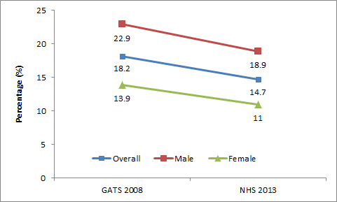
Monitoring Tobacco Use Over Time Using TQS: Brazil
Prevalence of current tobacco smoking among adults aged 18 and above in Brazil
Source: Global Adult Tobacco Survey (GATS-2008) & National Health Survey (NHS-2013)

Slide 36
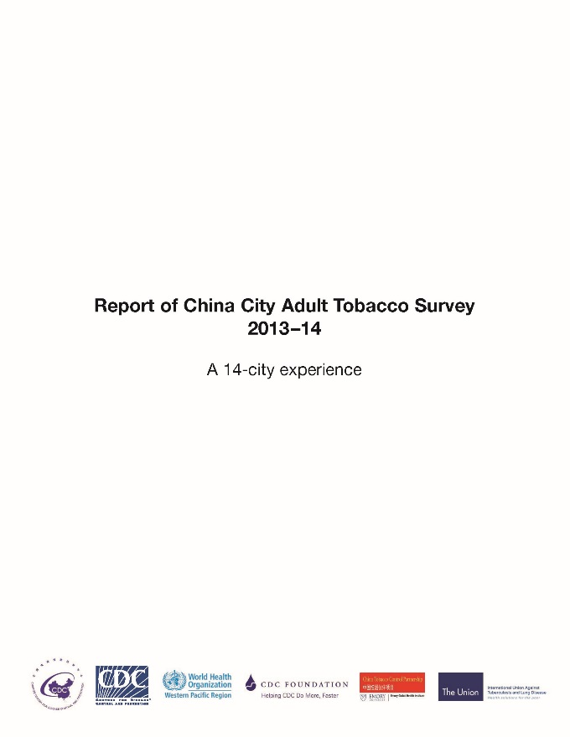
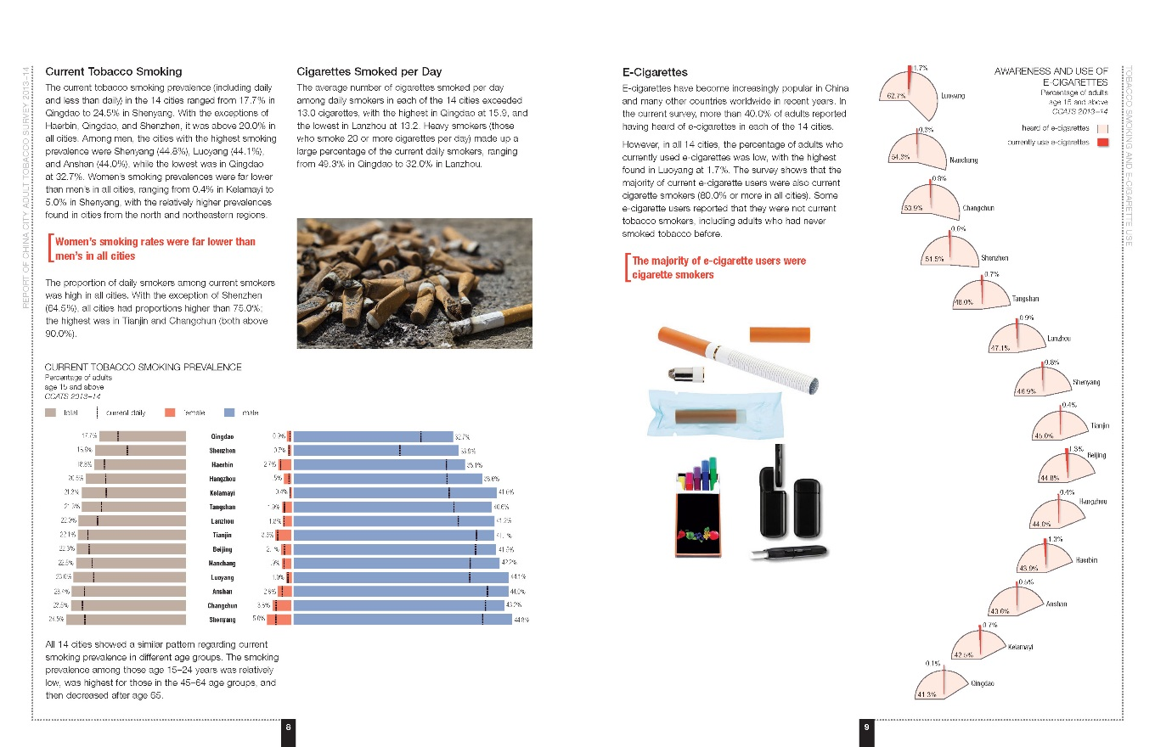
Subnational Monitoring Using TQS:
China City Adult Tobacco Survey

Slide 37
Partnerships &
Global Alliance

Slide 38




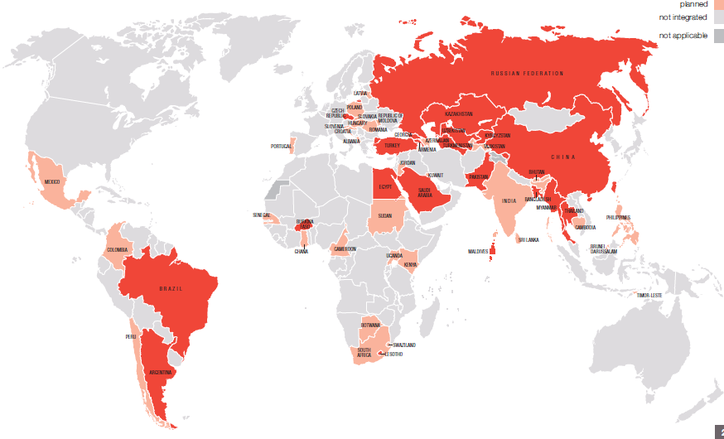
Notes:
For example, Vietnam has agreed to integrate TQS into it’s National Household Living Standards Survey in 2016

Slide 39
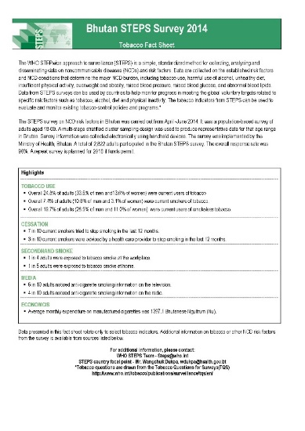
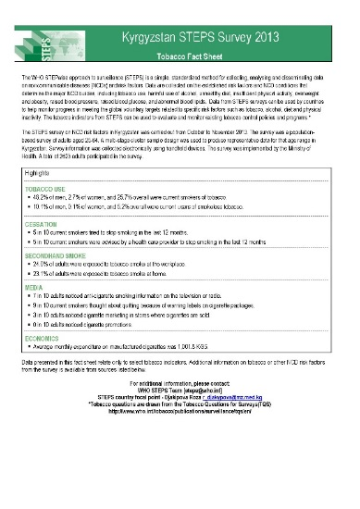
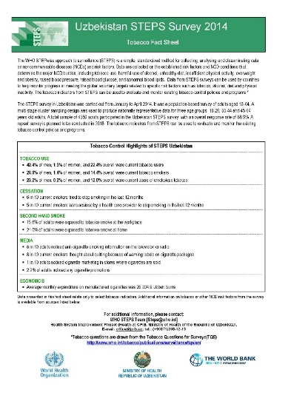
Formal Partnerships
WHO STEPwise approach to Surveillance (STEPS)
  Funding provided for inclusion of TQS
    Round 1: 10 completed countries
    Round 2: 11 countries (ongoing)

Slide 40
Formal Partnerships
OIC Statistical, Economic and Social Research and Training Centre for Islamic Countries (SESRIC)
  Funding provided for SESRIC engagement with national statistical organizations of OIC countries for TQS inclusion
    15 countries (5 completed)

Slide 41
SESRIC: Fieldwork Completed in 2015
Analysis completed with populated tables:
  Azerbaijan: National Household Budget Survey
  Egypt: National Labour Force Survey
  Indonesia: National Socioeconomic Survey
  Mauritania: Multiple Indicators Cluster Surveys
Analysis in-progress:
  Senegal: Demographic and Health Survey

Slide 42
Tobacco Questions for Surveys (TQS):
A Subset of Key Questions from the Global Adult Tobacco Survey (GATS)
Orientation Workshop on TQS
3-4 May 2016
Ankara, Turkey

