Slide 1


STATISTICAL, ECONOMIC AND SOCIAL RESEARCH AND TRAINING CENTRE FOR ISLAMIC COUNTRIES (SESRIC)
ORGANISATION OF ISLAMIC COOPERATION (OIC)
Guidelines for Preparing, Drafting and Submitting Progress Reports on Implementing OPAAW:
OPAAW Survey
Training Session on Guidelines for Preparing, Drafting and Submitting Progress Reports on Implementing OPAAW
17-18 September 2019
Ankara, Republic of Turkey

Slide 2
Outline
I. INTRODUCTION
II. DETAILS OF THE OPAAW SURVEY
III: IMPLEMENTATION

Slide 3
I. INTRODUCTION

Slide 4
Why there is need for OPAAW Survey?
Survey Part helps on how to measure & report efforts towards implementing OPAAW
  Enable member states to measure progress in a standardized way
  Enable member states to report progress in a standardized way
A benchmark to monitor & improve national performance of OIC Countries.

Slide 5
Why the need for a unified mechanism?
  Enable the OIC GS to improve intra-OIC cooperation
  Formulate new and innovative solutions based on a comparative and thorough understanding
As such, the GS can better assist Member States
Better implementation of OPAAW
Greater ability to tackle challenges faced by women &
By National Institutions

Slide 6
Proposed tools for a unified mechanism
National Progress Reports & the OPAAW Survey
The concept paper presents two main tools to establish a unified mechanism:
OPAAW National Progress Reports
The OPAAW Survey and Index

Slide 7
Triangulation: Reports and Survey
A syngery between qualitative and quantitative data
National Progress Reports
OPAAW Survey
In-depth & interpretive coverage of the status of women in any given state
Explain and elaborate on country specific achievements and challenges
Hermeneutics and subjective scale!
Narrative, causes and factors
Quick & quantifiable measurement of OPAAW objectives (data set).
Common and comparable indicators
Objective representation.. Yet ‘Numbers don’t lie, but they may omit!’
Track and monitor relative performance

Slide 8
Triangulation: Reports and Survey
A syngery between qualitative and quantitative data
Example
Survey:
identify and measure any increase (or decrease) on women’s labor force participation quantifiably,
Reports:
Understand and describe why such change has (or has not) occurred.
  Root causes and challenges

Slide 9
II: DETAILS OF THE OPAAW SURVEY

Slide 10
OPAAW Survey: Introduction
Designed to measure the recorded progress by OIC Member States in the implementation of OPAAW in a systematic way in a given time period.
It is constructed based on the amended OPAAW and its implementation matrix (i.e. objectives, sub-objectives and indicators were taken into account).
Responses will be used to calculate a composite index called the OPAAW index to reflect the relative performance of OIC Member States in a scale of 0-100.

Slide 11
Structure of the Survey
Part A:
A.1: Seven questions look at the status of 54 different policy-measures
A.2: Seven questions focus on the 237 indicators related with the women advancement in OIC Member States
Part B:
Five questions are about diagnostics (challenges and best-practices etc.)
It is not included in the OPAAW index scoring
Notes:
In total: 19 questions

Slide 12
Part A.1: Questions on Policy Measures
A.1.1 Which measures did your country implement to improve participation of women in decision-making?
A.1.2 Which measures did your country implement to improve education status of women?
A.1.3 Which measures did your country implement to improve health status of women?
A.1.4 Which measures did your country implement to empower economic status of women?
A.1.5 Which measures did your country implement to improve social protection of women?
A.1.6 Which measures did your country implement to protect women from violence?
A.1.7 Which measures did your country implement to improve status of women in crisis situations?

Slide 13
Part A.2: Questions on Indicators
A.2.1 In which indicators on participation of women in decision-making did your country record a progress?
A.2.2 In which indicators on education of women did your country record a progress?
A.2.3 In which indicators on health of women did your country record a progress?
A.2.4 In which indicators on economic empowerment of women did your country record a progress?
A.2.5 In which indicators on social protection of women did your country record a progress?
A.2.6 In which indicators on protection of women from violence did your country record a progress?
A.2.7 In which indicators on status of women in crisis situation did your country record a progress?

Slide 14
Part B: Questions on Diagnostics (best-practices, challenges etc.)
B.1 Which of the following OIC programmes do you know that can facilitate the implementation of OPAAW by your country?
B.2 Which of the following OIC programmes have your country benefited that can facilitate the implementation of OPAAW?
B.3 Please let us know to which extent the followings are a challenge in your country in the implementation of OPAAW.
B.4 Please let us know in which of the following areas does your country have national best-practices (e.g. policy, initiative, and project etc.) that can facilitate reaching the objectives of OPAAW.
B.5 Please let us know in which of the following areas does your country need support and/or assistance in reaching the objectives of OPAAW.

Slide 15
An example question
A.1.1 Which measures did your country implement to improve participation of women in decision-making?

Slide 16
Progress Does Not Come by Chance
OIC countries with a gender quota of 50% include:
Afghanistan
Algeria
Mauritania
Senegal
Sierra Leone
Togo
Tunisia.
**Considering the current trend, it is estimated that OIC region will achieve an average of 30% women representation in parliaments by 2040.

Slide 17
Response Categories
A response of “Yes” will be translated into a score of “1”.
A response of “No” associates with a score “-1”.
A response of N/A (not available/do not know) will be reflected with a score of “0” in the assessment of the Survey.

Slide 18
OPAAW Index: Weights
weight part A.1 (measures) (7 questions) | 70%
weight part A.2 (indicators) (7 questions) | 30%
Notes:
Based on 291 responses and by taking assigned weigthts in to account, a composite index is developed to reflect the relative performance of OIC countries.

Slide 19
OPAAW Index: Results
The OPAAW Index Maximum and Minimum Values
maximum score | 100
minimum score | 0
Country Classification Based on their OPAAW Index Scores
On-Track | equal and higher than 60
Off-Track | below 60

Slide 20
A Hypothetical Example: Country Orange
Country Orange
 | Yes | No | N/A
part A.1 | 30 | 20 | 4
part A.2 | 200 | 30 | 7
Net Score
part A.1 | 10
part A.2 | 170
Weighted Net Score
part A.1 | 7
part A.2 | 51
Sum of Weighted Net Score | 58
OPAAW INDEX SCORE of COUNTRY ORANGE
= 76.6
ON TRACK

Slide 21
Part III. IMPLEMENTATION

Slide 22
Framework of the Survey
The Survey will be filled out online by the focal point assigned by his/her country periodically (every two-year).
Arabic: https://www.surveymonkey.com/r/opaaw-ar
English: https://www.surveymonkey.com/r/opaaw-en
French: https://www.surveymonkey.com/r/opaaw-fr
S/he is expected to be a senior level decision-maker at the Ministry of Women Affairs/State Commission on Women Advancement or any other relevant public authority.
Notes:
In the second week of May, a reminder will be sent to OIC Member States to increase the number of participation into the survey.

Slide 23
Framework of the Survey
English:
https://www.surveymonkey.com/r/opaaw-en
Notes:
In the second week of May, a reminder will be sent to OIC Member States to increase the number of participation into the survey.

Slide 24
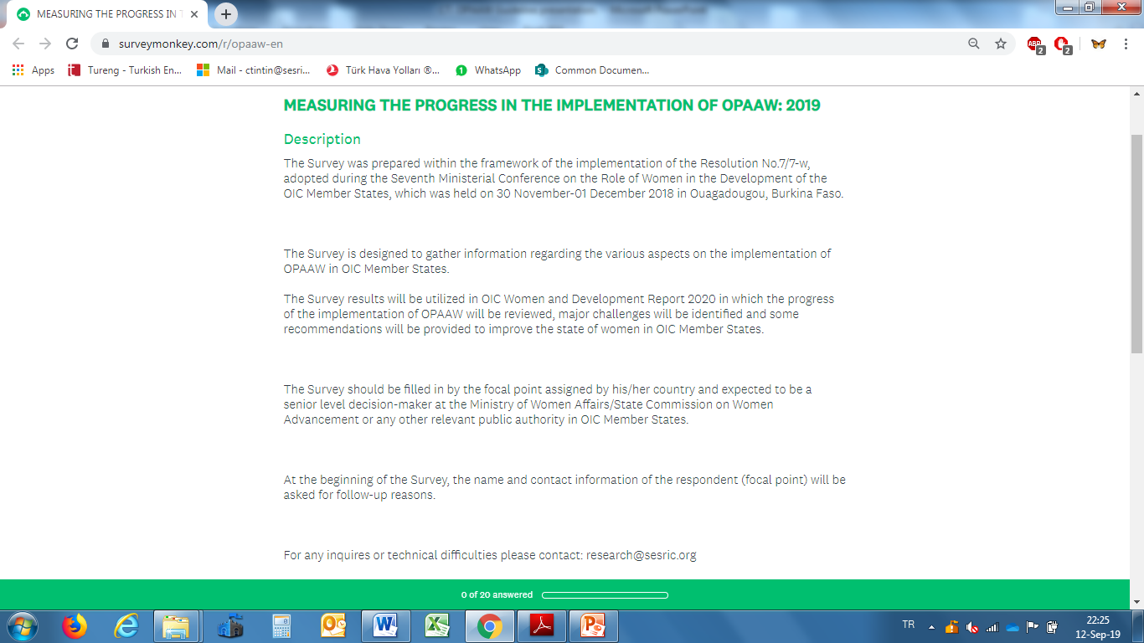

Slide 25
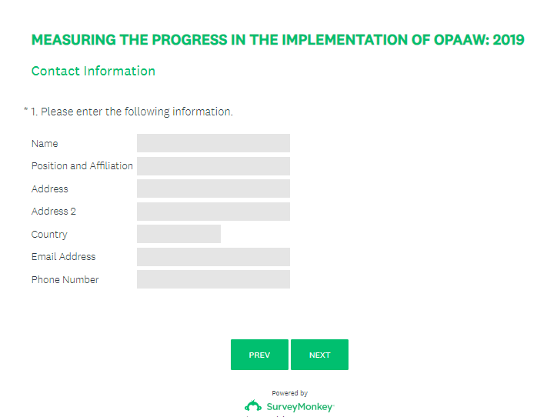

Slide 27
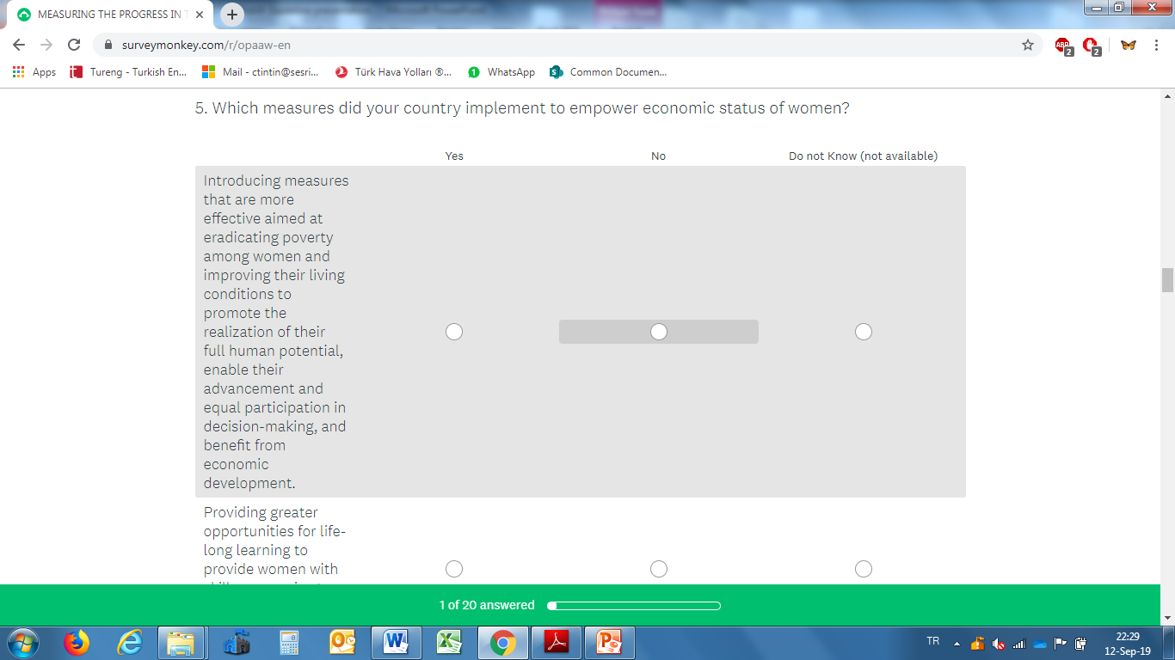

Slide 28
SUCCESS STORIES FROM SELECTED OIC COUNTRIES ON WOMEN ENTREPRENEURSHIP INITIATIVES TOWARDS ECONOMIC EMPOWERMENT
1. Uganda Women Entrepreneurship Program ( UWEP) – Uganda
2. Women Entrepreneurship Development Programme (WEDP) – Nigeria
3. Entrepreneurship Development and Investment Promotion Programme –Bahrain
4. SME Corporation – Malaysia
5. Financing Cottage, Micro, Small, and Medium Enterprises through Women Entrepreneurship Development Unit – Bangladesh
6. The Women Business Development Centre (WBDC) – Egypt

Slide 29
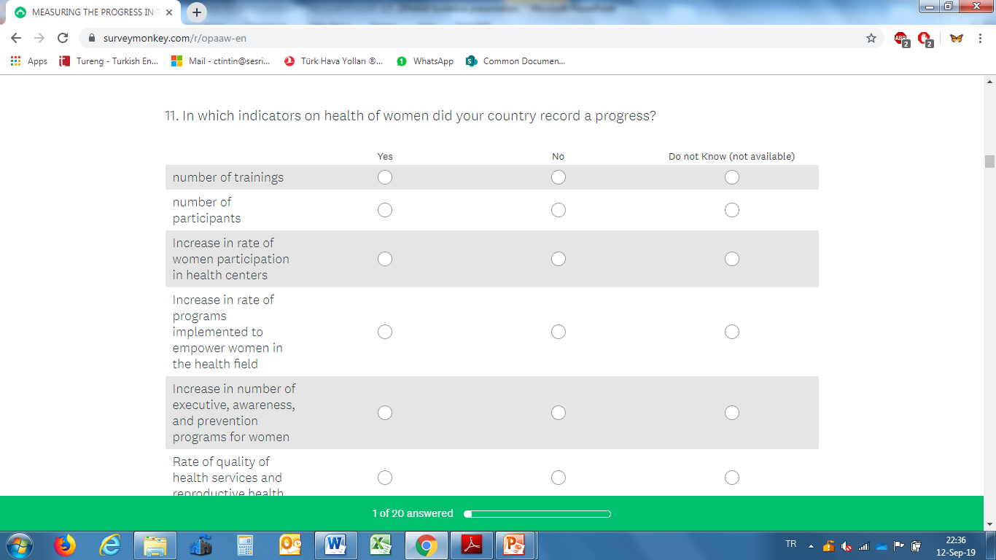

Slide 30
Health:
Success Story of Bangladesh in Reducing Maternal Mortalities.
Highlighted in various UN Reports and WHO Reports.
But how Bangladesh achieved this was possible in short period of time?

Slide 31
Framework of the Survey
Example Timeline:
April: A Note Verbale will be sent to Focal points to inform them about the start of the filling period.
April-May: Focal points fill the survey.
June: Will be used to assess the survey results.
July and August: Will be used by the OIC General Secretariat to prepare the progress report of the Secretary General to be submitted to the Ministerial Conference on Women’s Role in the Development of OIC Member States.
The survey results will also be used by SESRIC in preparing the periodical report titled “OIC Women and Development Report” in which performance of countries will be listed and elaborated.
Notes:
In the second week of May, a reminder will be sent to OIC Member States to increase the number of participation into the survey.

Slide 32
Conluding Remarks:
Key Elements for a Successful Implementation
Identify the Focal Point;
Do not underestimate or overestimate your performance;
If you do not know or could not decide, do not hesitate to select «DO NOT KNOW» option.

Slide 33
NEXT STEPS:
The OIC General Secretariat will send a Note Verbale to your country through diplomatic channels. It will include deadline, online links and password required.
Your Ministry will receive it and will designate a focal point to fill out the Survey.
Open the link provided in the Note Verbale by entering the password and fill out the online survey of 20 questions.
Finally push the DONE button.
You will see a Thank you screen. It is done. You successfull

Slide 34

NEXT STEPS:
Finally push the DONE button.
You will see a «Thank you» message. It is done.
You successfully submitted the OPAAW Survey.

Slide 35
IMPORTANT SUGGESTIONS!
PLEASE READ and STUDY the GUIDELINE DOCUMENT AND ITS ANNEX to FINALIZE YOUR RESPONSES BEFORE OPENING UP THE ONLINE LINK!
MAKE SURE THAT YOU HAVE PREPARED ALL RESPONSES IN THE SURVEY BEFORE OPENING UP THE ONLINE LINK!

Slide 36
NEXT STEPS:
DO NOTs:
DO NOT Fill out the printed copy of the Survey, PLEASE!
DO NOT Send the printed Survey to the OIC GS with a Note Verbale, PLEASE!
DO NOT Miss the deadline indicated in the Note Verbale for filling out, PLEASE!
DO NOT Close your browser before pushing the done button, PLEASE!

Slide 37

THANK YOU
MERCI
شكرا
Statistical, Economic and Social Research and Training Centre For Islamic Countries (SESRIC)
Organisation of Islamic Cooperation (OIC)
Training Session on Guidelines for Preparing, Drafting and Submitting Progress Reports on Implementing OPAAW
17-18 September 2019
Ankara, Republic of Turkey

